Slide 1
Classes and Objects
Lesson 1

Slide 2
What is a class?
Think of a class as nothing more than a simple blueprint or template.
Inside this template you have details such as properties and behaviors.
Properties are like characteristics (like a dog has four legs).
Behaviors/methods are like actions (like a dog can bark).

Slide 3
What is an Object?
An object is simply an object that you create from a defined class type.
What the heck does that mean?
Remember we said classes are like templates. Well, objects are created using those templates.

Slide 4
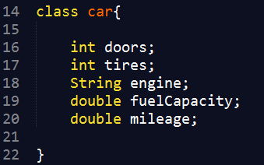
What goes inside a class?
Properties and behaviors are defined within a class
Properties are characteristics. For example:

Slide 5
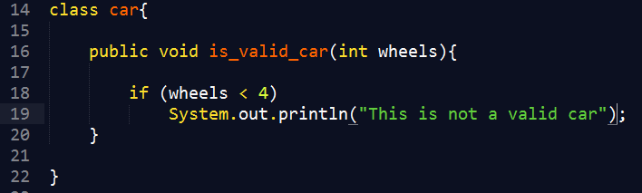
Behaviors are methods. For example:

